Slide 1
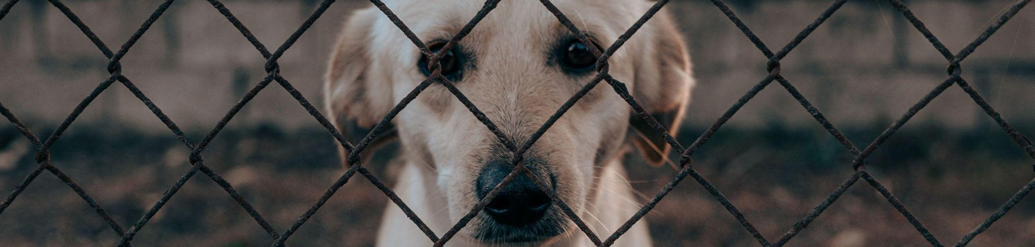
Will this animal be adopted?
MACHINE LEARNING PROJECT · IRONHACK
Predicting adoptions at the Austin Animal Center
Raquel Marques
Notes:
Hi everyone! My project is about animal shelters.
I wanted to answer one question: can a shelter predict, on the first day, if an animal will be adopted?
Let’s see if Machine Learning can help!

Slide 2






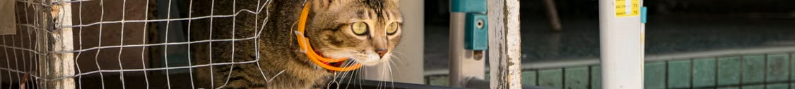
Adopted or not? A yes / no prediction
1. Data
2. Prepare
3. Split
4. Train
5. Test
80k animals
New features
80% / 20%
5 models
8 in 10 found
THE PROBLEM AND THE DATA
79,671
Source: Austin Animal Center (Texas), the largest no-kill shelter in the USA – Kaggle
animals, 2013–2018
Target: adopted (1 = yes, 0 = no)
42%
Features: animal type, age, sex, breed, color, how and in what condition it arrived, month
were adopted
⚠️ No data leakage: only information from the day the animal arrives.
2
Notes:
For this project, I used data from the Austin Animal Center in Texas.
The dataset has around 80,000 animals, and about 42% of them were adopted.
My goal was to build a classification model that predicts if an animal will be adopted or not.
I used features like animal type, age, sex, breed, color, intake type, intake condition and month.
I only used information available when the animal arrived, to avoid data leakage.

Slide 3


From messy text to useful numbers
1. Data
2. Prepare
3. Split
4. Train
5. Test
80k animals
New features
80% / 20%
5 models
8 in 10 found
FEATURE ENGINEERING
Before | After
“Neutered Male” | is_male, is_sterilized
2,155 breeds | is_mix + top 10 breeds
529 colors | is_multicolor + top 10 colors
age | is_baby (under 1 year)
month | season
Babies (under 1 year)
51% vs 36%
adopted, vs older animals
Mixed breeds
43% vs 27%
Then one-hot encoding: text → 0/1 columns (44 features).
adopted, vs pure breeds
3
Notes:
When I explored the data, I found too many categories, especially for breeds and colors.
I simplified these categories and created new features, such as identifying baby animals and mixed breeds.
Then, I used one-hot encoding to convert categorical variables into numerical columns, making the data suitable for Machine Learning models.
Finally, I found that younger animals and mixed breeds had higher adoption rates in this dataset.

Slide 4


Tuning made the biggest difference
1. Data
2. Prepare
3. Split
4. Train
5. Test
80k animals
New features
80% / 20%
5 models
8 in 10 found
MODELS AND TUNING
Why F1? The baseline gets 58% accuracy, but finds zero adopted animals.
Random Forest
0.693
Gradient Boosting
0.691
Decision Tree
0.687
Grid Search + class_weight = “balanced”: Decision Tree F1 from 0.60 to 0.69, and no more overfitting.
Logistic Regression
0.661
KNN
0.606
4
Notes:
After preparing the data, I split it into two sets: 80% for training and 20% for testing.
The training data was used to teach the models, while the test data was used to evaluate their performance on unseen data.
I then trained and compared five different models. I used the F1 score as my main metric because accuracy alone can be misleading when the data is imbalanced. That means we have more animals that were not adopted than animals that were adopted. A model could have good accuracy but still fail to identify adopted animals.
Finally, I used Grid Search and cross-validation to find better parameters for my models. This improved the Decision Tree's F1 score from 0.60 to around 0.69.
The Random Forest achieved the highest F1 score in my final comparison, although the differences between the top models were small.

Slide 5

🏆 Winner: Random Forest
1. Data
2. Prepare
3. Split
4. Train
5. Test
80k animals
New features
80% / 20%
5 models
8 in 10 found
KEY FINDINGS · IT FINDS 8 IN 10 ADOPTED ANIMALS
Recall 80% · Accuracy 70% · F1 0.69
Confusion matrix
What matters most?
Predicted: no
Predicted: yes
1. Age
Really not adopted
5,867
3,349
2. Given up by owner
✓ correct
✗ wrong
3. Baby (under 1 year)
1,379
5,340
4. Sex unknown
Really adopted
5. Found as a stray
✗ missed
✓ found
How much F1 drops when the feature is shuffled
5
Notes:
The best model was the tuned Random Forest.
It achieved an F1 score of 0.69, an accuracy of 70%, and a recall of 80%.
The confusion matrix compares the model's predictions with what actually happened. It correctly identified 5,340 animals that were adopted and 5,867 that were not adopted. However, it missed 1,379 animals that were eventually adopted, and incorrectly predicted adoption for 3,349 animals.
Finally, I used permutation importance to understand which features were most useful for the model. Age was the most important, followed by whether the animal was given up by its owner and whether it was a baby.

Slide 6
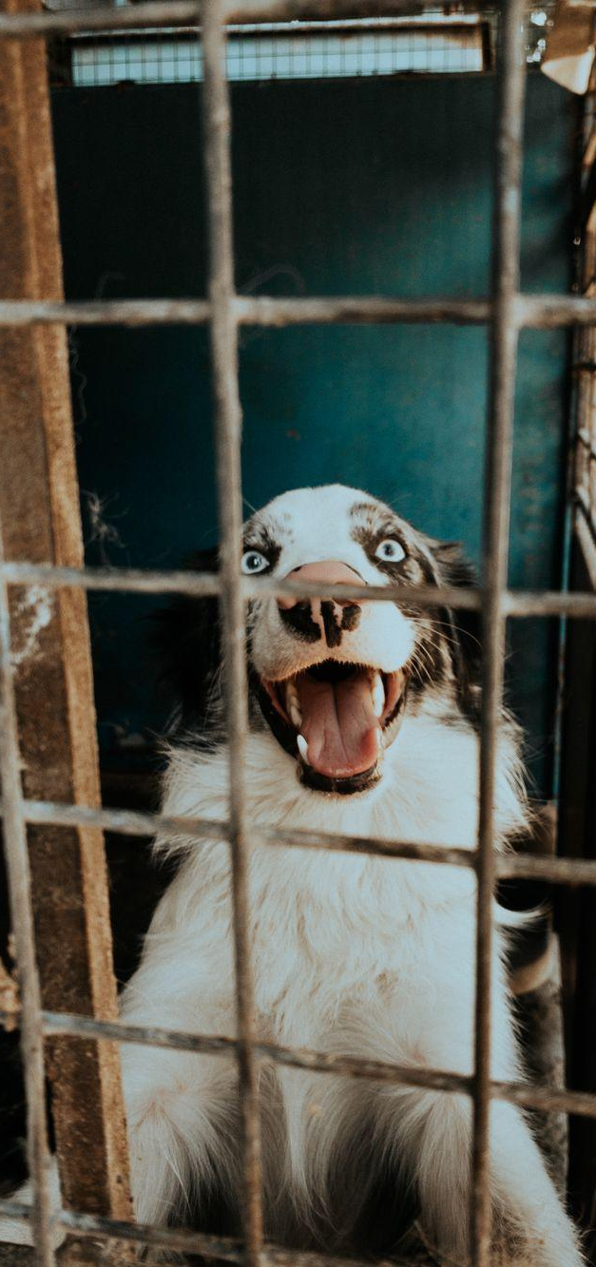

Any shelter with this kind of data can use it
REAL-WORLD IMPACT
1. Predict
2. Promote
3. Home 🐾
On day one, find the animals with a low chance
Invest more in them: photos, posts, events
The others already find a home on their own
6
Notes:
So, how can this be useful in the real world?
Any shelter with the same kind of data can use this model.
On the first day, it finds the animals with a lower chance of adoption, so the shelter can give them more support: better photos, social media posts or adoption events.
The goal is simple: a home for every animal.

Slide 7
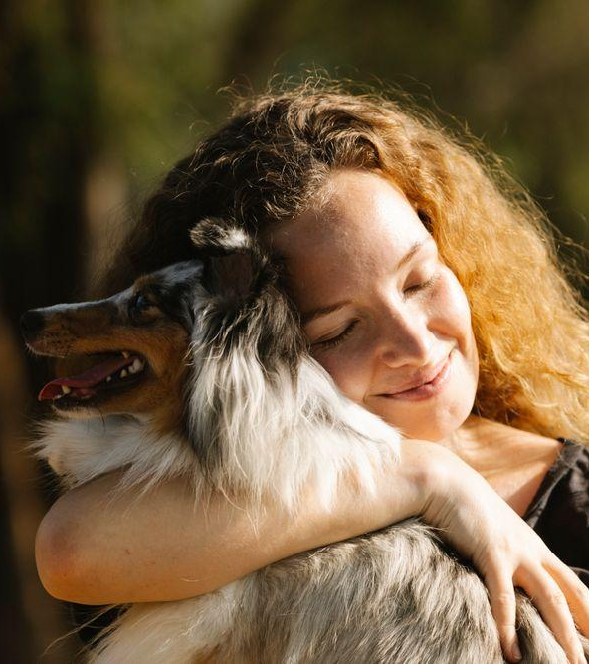
Thank you!
A HOME FOR EVERY PAW
Questions?
Raquel Marques
7
Notes:
To conclude, this project showed me how Machine Learning can help with a real problem.
The model is not perfect, but it can help shelters give more visibility to the animals that need it most.
Thank you for listening!

